Slide 1
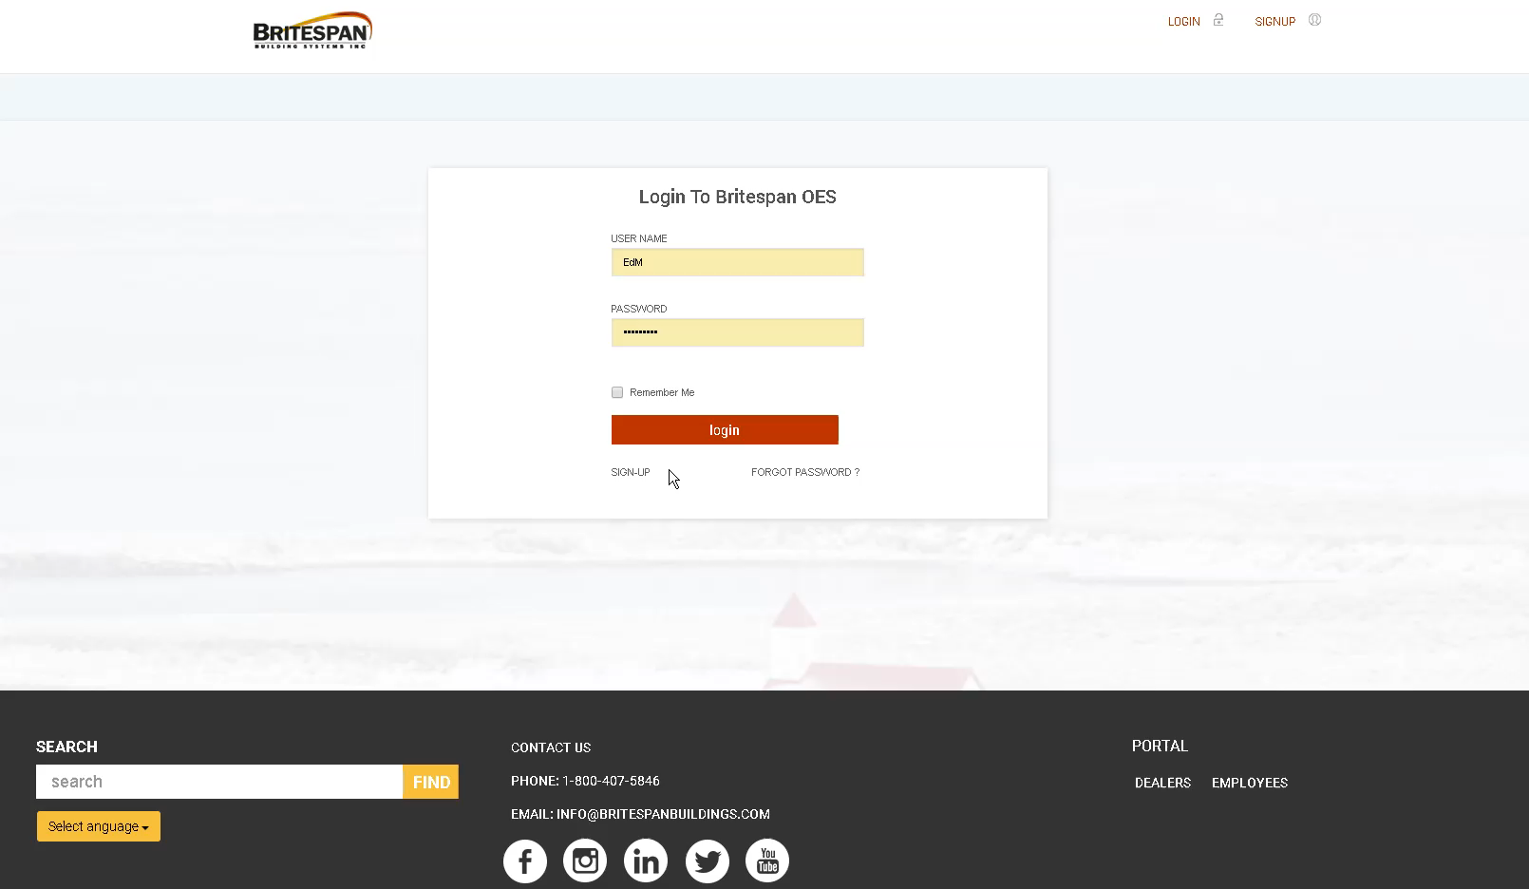
OES Test Kitimat BC – Ed M
20.July.2018

